Slide 1

The restaurant website
using html and css
Syed ikrash ahmed
Syeda Fatima waseem
Hafsa ayubi

Slide 2

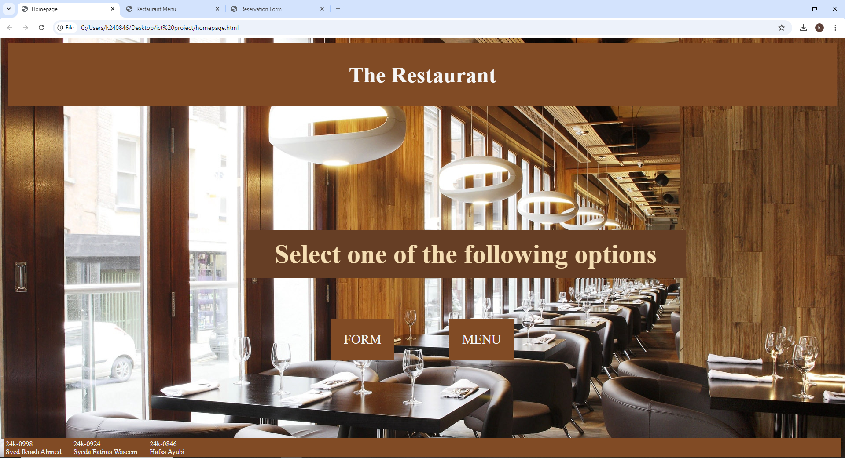
homepage
Header
Background image
2 buttons for form & menu
Footer

Slide 3
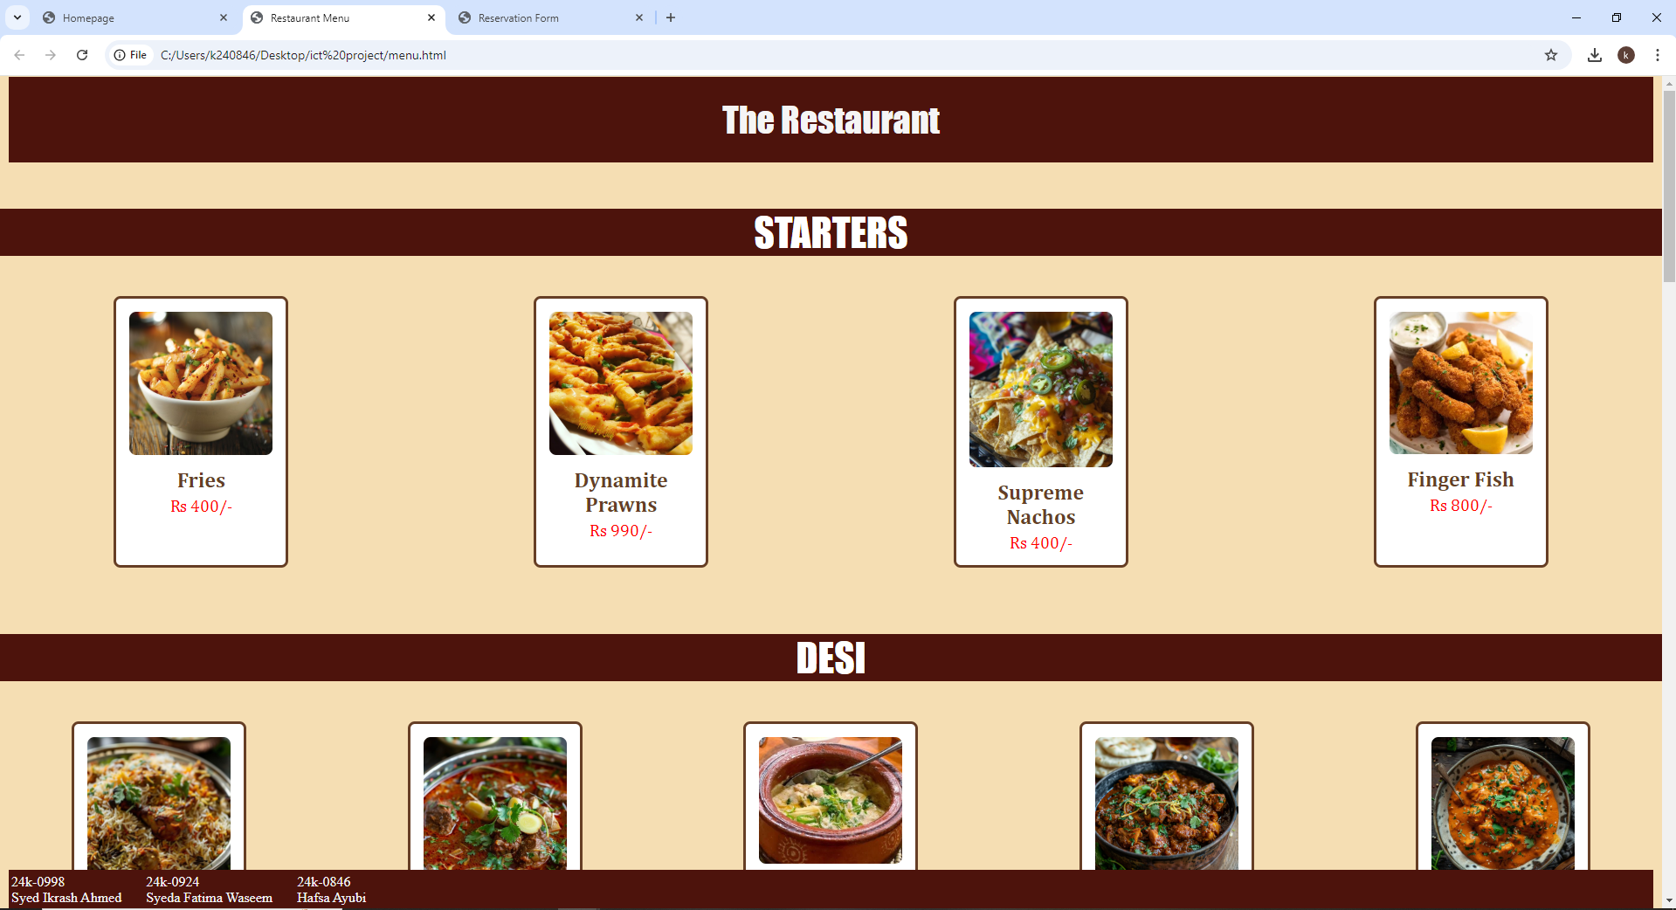
MENU
Header
Background color
Each menu section heading
Name and price of each menu item
Image for each menu item
Footer

Slide 4
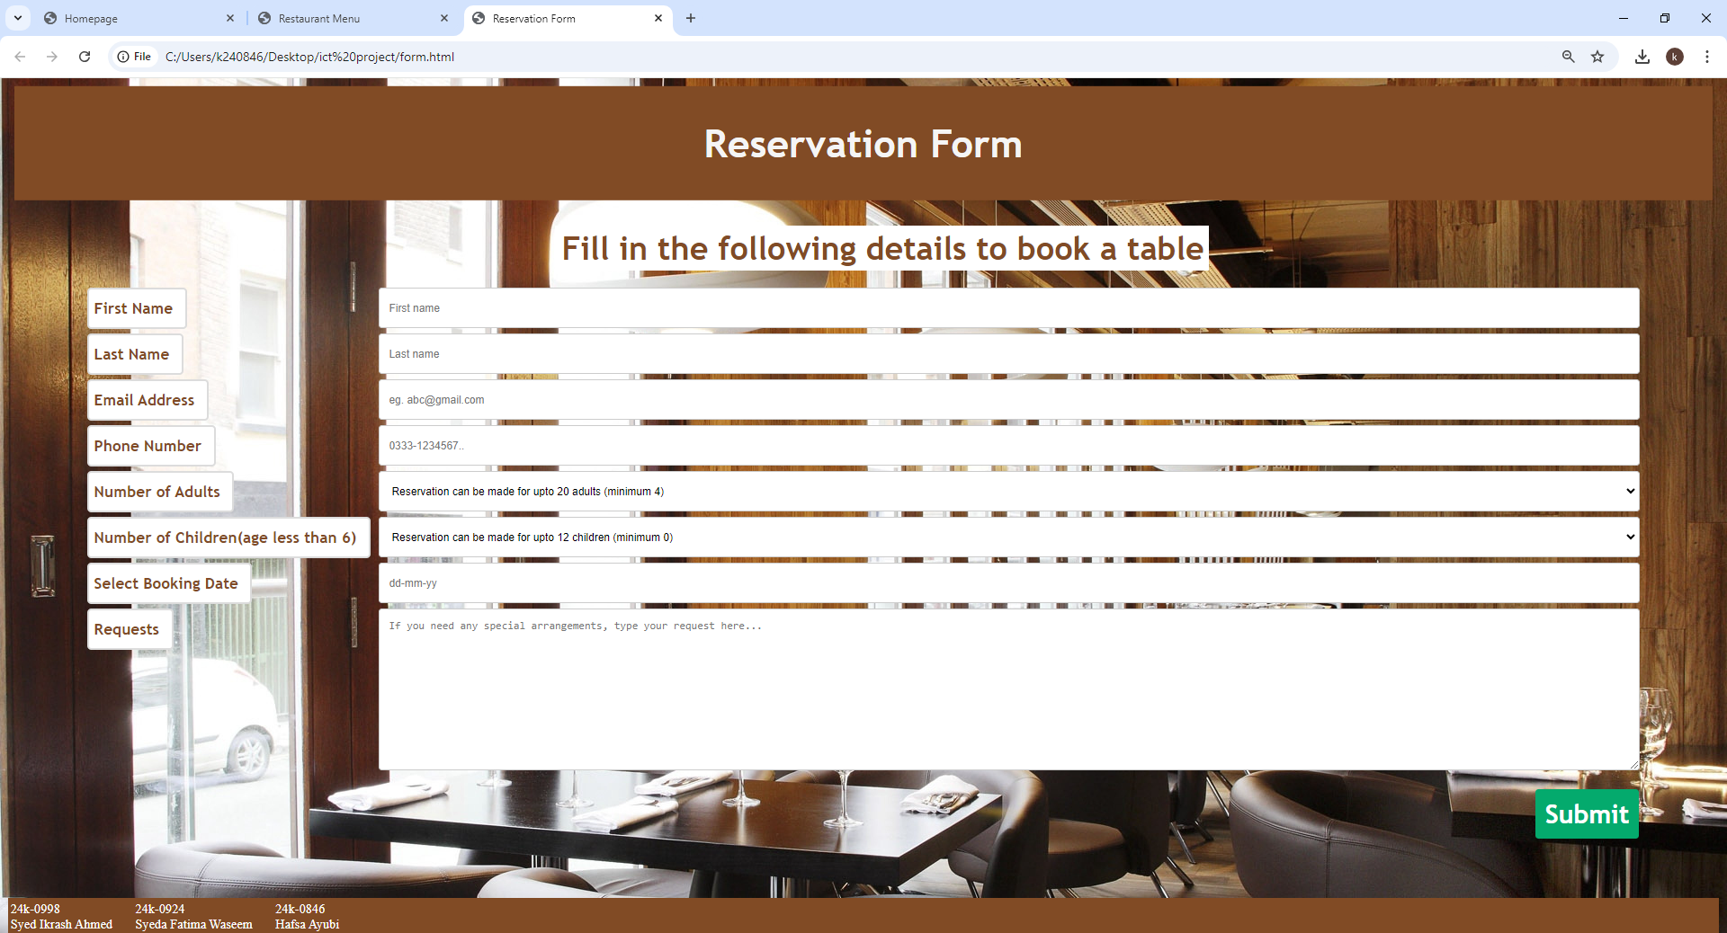
Reservation form
Header
Background image
Label column
Input column
Submit button
Footer

Slide 5
references
W3schools https://www.w3schools.com/
Kababjees https://order.kababjees.com/
Lal qila (form) https://lalqila.com/karachi/reservation/

